Slide 1
Leveraging Technology to Improve Customer Experience while signing for Insurance
PIP2001 Capstone Project
Final Viva-Voce
Batch Number:
Roll Number | Student Name
20211CSE0674 | Rohit S M
20211CSE0631 | Prashanth S N
20211CSE0666 | Nithin H M
20211CSE0671 | Dhanush C R
20211CSE0889 | Kanala Krishna
Under the Supervision of,
Mr. Syed Mohsin Abbasi
School of Computer Science and Engineering
Presidency University
Name of the Program: CSE
Name of the HoD: Dr. Asif Mohamed H B
Name of the Program Project Coordinator: Mr. Syed Mohsin Abbasi
Name of the School Project Coordinators: Dr. Sampath A K / Dr. Abdul Khadar A / Mr. Md Ziaur Rahman

Slide 2
Introduction
Insurance heavily relies on building trust and maintaining transparency with customers.
Increasing customer demand for clarity and accessibility in policy information has become crucial.
Many customers do not carefully read lengthy and complex policy documents, leading to confusion about policy terms, coverage, and exclusions.
The lack of awareness hinders customer understanding and decision-making regarding insurance policies.
Simplifying and improving access to key policy details can significantly enhance customer satisfaction and trust.

Slide 3
Literature Review
Advantages of existing method
Human Touch: Customers often prefer speaking directly to an expert, providing reassurance when making complex financial decisions
Comprehensive Responses: Experts are able to address detailed questions and provide in-depth explanations, which is valuable for decision-making.
Limitations of existing method
Limited Availability: Many studies highlight that customer service experts are not available 24/7, causing delays in resolving queries
Inconvenience: Research indicates that waiting on hold and the time taken to get queries answered makes this method inefficient compared to modern solutions
Transparently Opaque: Understanding the Lack of Transparency in Insurance Consumer Protection (umn.edu)

Slide 4
Existing method Drawback
Policy Bazar Claim Assistance
Lack of Clarity: Before buying insurance, many customers find it difficult to understand the complex terms, conditions, and coverage details.
Dependence on Human Agents: Many rely on calling an expert for clarification, which might not be easily accessible or could vary in quality and may be baised.
Time-Consuming Documentation: Traditional documents such as example policy documents for life insurance are often dense and not user-friendly, leading to information overload or confusion.
Example: Document for Life Insurance

Slide 5
Proposed Method
Requirement Analysis: Identified key challenges like document complexity, language barriers, and limited accessibility of policy details.
System Design: Designed a scalable architecture integrating AI for document summarization, translation, and chatbot functionalities.
AI Implementation: Implemented models to extract and summarize clauses, translate documents into regional languages, and provide intelligent chatbot responses.
Backend Development: Built RESTful APIs for secure data storage, retrieval, and interaction with the AI components.
Frontend Integration: Created a user-friendly interface for document uploads, chatbot interaction, and displaying policy summaries.
Deployment and Monitoring: Deployed on a cloud platform

Slide 6
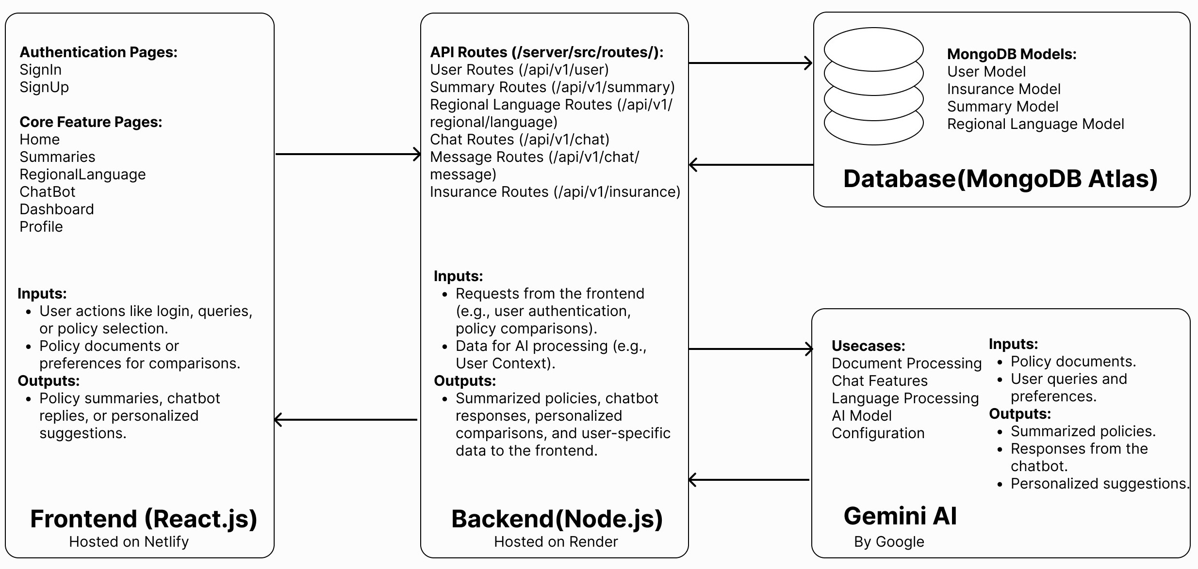
Proposed Method
Architecture:

Slide 7
Software/Hardware Requirements
Software Requirements:
1. Operating System
Windows, macOS, or Linux: Any modern OS capable of running development environments.
2. Development Environment
Code Editor: Visual Studio Code
Node.js: For back-end development and running JavaScript on the server side.
Database Management Tool: MongoDB.
3. Version Control
Git: For managing version control and collaboration.
GitHub: For hosting the repository.

Slide 8
Software/Hardware Requirements
Hardware Requirements:
1. Development Machine
Processor: Intel i5 (or equivalent AMD) or higher.
RAM: 8GB or more for handling multiple tasks such as running the local server, browser, and development tools simultaneously.
Storage: 256GB SSD or more for faster performance and to handle development tasks quickly.
2. Internet Connection
Stable broadband connection for accessing APIs, cloud storage, and deploying the application to cloud platforms.

Slide 9
Objectives
Regional Language Translation: Implementing AI-based language translation tools to convert policies into multiple regional languages.
Chatbot for Queries: Build a chatbot to handle customer queries related to policies and provide instant support.
Document Summarization: Automatically summarize complex policy documents into simple, jargon-free text.
Backend API as Microservice: Developing and deploying a scalable microservice for the policy management and delivery system, accessible through backend APIs.
Text-to-Speech for Summaries: Integrate Text-to-Speech technology to convert summarized policy text into audio for improved accessibility.

Slide 10
Timeline of Project
Task | Review 0 | Review 1 | Review 2 | Review 3 | Final Viva-Voce
Planning & Requirements
Front-End Design
Front-End Development
Back-End Development
Database & Multimedia Setup
QR Code & API Integration
Testing(Front-End/Back-End)
User Testing & Feedback
Final Bug Fixes
Final Testing & Development

Slide 11
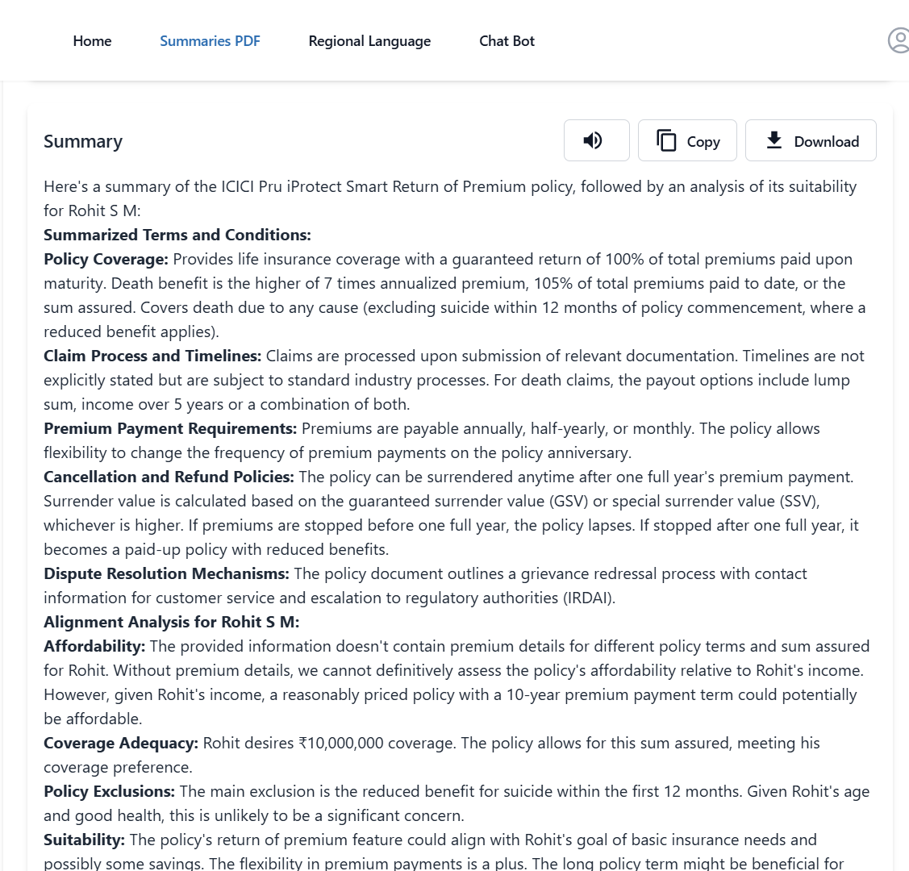
Outcomes

Slide 12
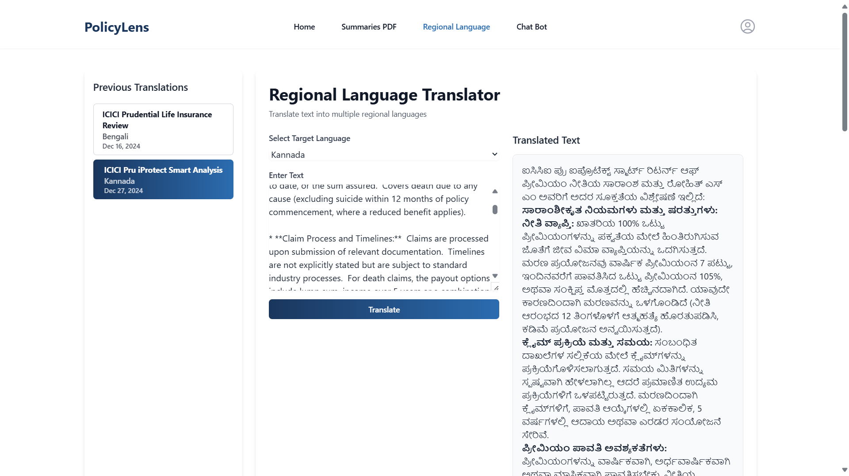

Slide 13
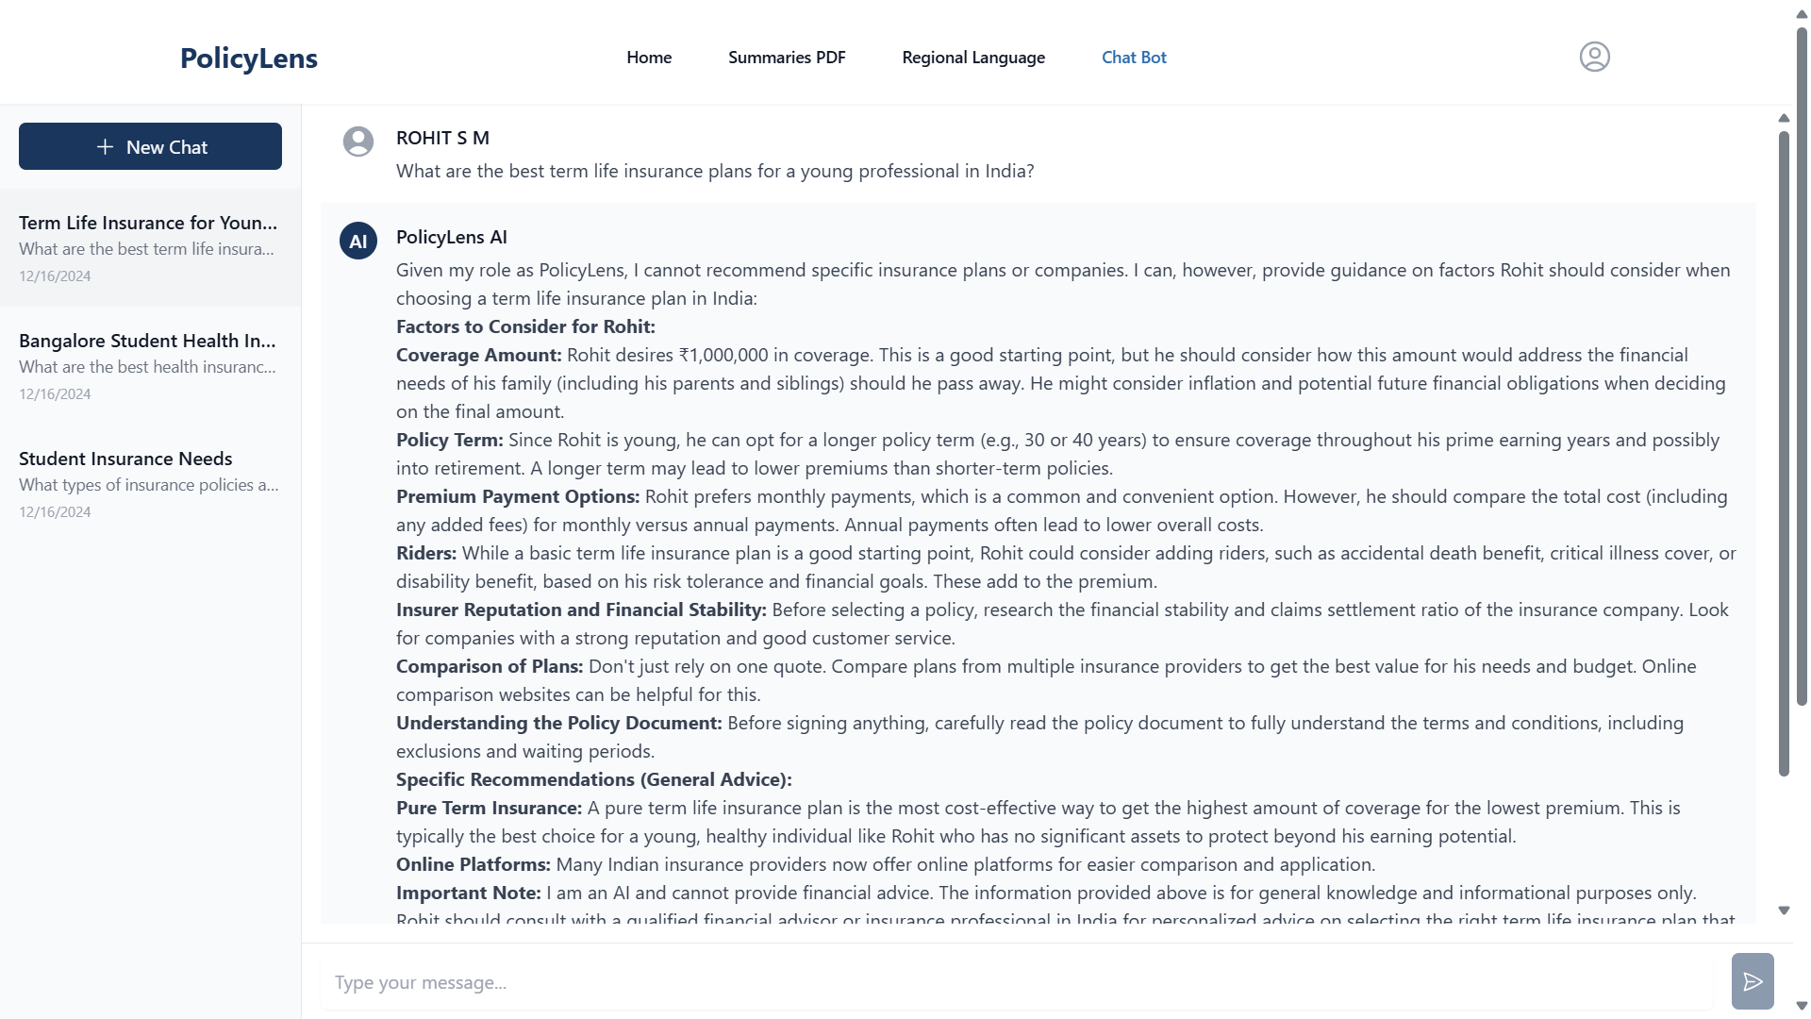

Slide 14
Conclusion
Empowering Customers: The project leverages technology to enhance customer understanding and navigation of insurance policies.
Improved Accessibility: Regional language translation and AI-driven summarization make complex information easier to understand for a diverse audience.
Enhanced User Engagement: Chatbot support provides instant assistance, while text-to-speech functionality caters to various learning preferences.
Building Trust and Transparency: Clear, concise communication fosters a trustworthy relationship between insurers and customers, addressing common pain points.
Transforming the Insurance Experience: The project aims to create a more inclusive, efficient, and user-friendly insurance process, enabling informed decision-making tailored to individual needs.

Slide 15
Github Link
The Github link provided has public access permission.
https://github.com/RohitM1518/PolicyLens.git

Slide 16
References
[1] Anderson, K., & Lee, S. (2023). "Secure Authentication in Financial Applications." IEEE Security & Privacy, 21(4), 78-93.
[2] Brown, T., & Davis, R. (2023). "User Profiling in Insurance Technologies." International Journal of InsurTech, 8(2), 123-138.
[3] Chen, H., & Wilson, K. (2023). "AI-Powered Insurance Document Processing." IEEE Transactions on Financial Technology, 15(2), 234-249.
[4] CloudinaryLtd. (2023). "Cloudinary Documentation for Document Management." Retrieved from https://cloudinary.com/documentation
[5] Express.js Foundation. (2023). "Express.js Security Best Practices." Retrieved from https://expressjs.com/en/advanced/best practice-security.html
[6] Google. (2023). "Gemini API Documentation." Retrieved from https://ai.google.dev/gemini-api/docs
[7] Li, X., & Wang, Y. (2023). "Speech Synthesis in Multi-language Applications." IEEE
Transactions on Audio Processing, 31(6), 789 804.
[8] MongoDB Inc. (2023). "MongoDB Atlas Documentation." Retrieved from https://www.mongodb.com/docs

Slide 17
Project work mapping with SDG
1. SDG 4: Quality Education Ensure inclusive and equitable quality education and promote lifelong learning opportunities for all.
Target 4.5 : By 2030, eliminate gender disparities in education and ensure equal access to all levels of education and vocational training for the vulnerable, including persons with disabilities, indigenous peoples, and children in vulnerable situations.
Project Alignment with Goal : The Text-to-Speech for Summaries feature converts written policy summaries into audio format, making information accessible to individuals with visual impairments or those who prefer auditory learning. This inclusivity ensures that vulnerable populations have equal access to educational content, promoting equitable quality education.
2. SDG 9: Industry, Innovation, and Infrastructure Build resilient infrastructure, promote inclusive and sustainable industrialization, and foster innovation.
Target 9.5 : Enhance scientific research, upgrade the technological capabilities of industrial sectors in all countries, particularly developing countries, including, by 2030, encouraging innovation and substantially increasing the number of research and development workers per 1 million people and public and private research and development spending.
Project Alignment with Goal : The integration of AI based Chatbot and Document Summarization showcases a commitment to technological advancement within the insurance sector. By adopting these innovative solutions, our project contributes to upgrading technological capabilities and encourages further research and development in applying AI to enhance customer experience.

Slide 18
Project work mapping with SDG
3. SDG 10: Reduced Inequalities Reduce inequality within and among countries.
Target 10.2 : By 2030, empower and promote the social, economic, and political inclusion of all, irrespective of age, sex, disability, race, ethnicity, origin, religion, or economic or other status.
Project Alignment with Goal : The Regional Language Translation feature ensures that insurance policies are available in multiple regional languages, breaking language barriers and promoting inclusivity. This empowerment enables individuals from diverse linguistic backgrounds to understand and access insurance products, fostering social and economic inclusion.
4. SDG 16: Peace, Justice, and Strong Institutions Promote peaceful and inclusive societies for sustainable development, provide access to justice for all, and build effective, accountable, and inclusive institutions at all levels.
Target 16.10 : Ensure public access to information and protect fundamental freedoms, in accordance with national legislation and international agreements.
Project Alignment with Goal : The combination of Document Summarization and Chatbot query resolution features ensures that complex policy information is transparent and accessible to the public. By demystifying insurance policies, our project promotes transparency and accountability within the insurance industry, contributing to building strong institutions.

Slide 19
Publication Details
Link : https://ijirt.org/Article?manuscript=171746

Slide 20
Thank You

